Slide 1
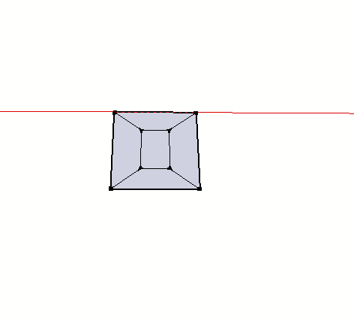
1 Create a simple gon

Slide 2
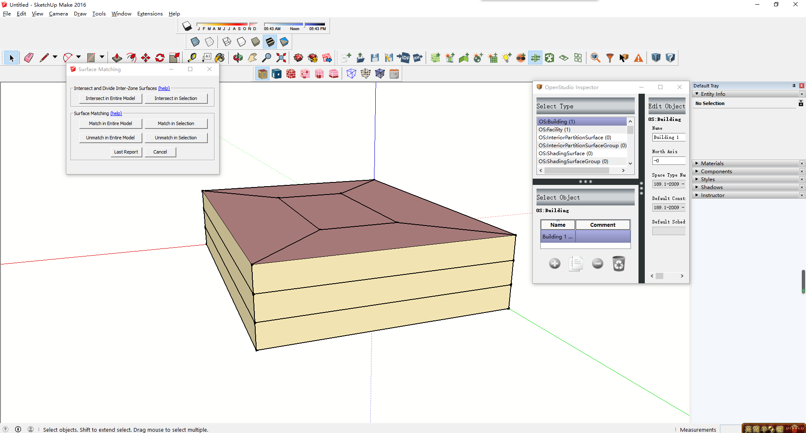
2 press “create spaces from diagram” buttom to create 3m heigh building

Slide 3
3 press surfaces matching-intersect in entire model to define surfaces

Slide 4
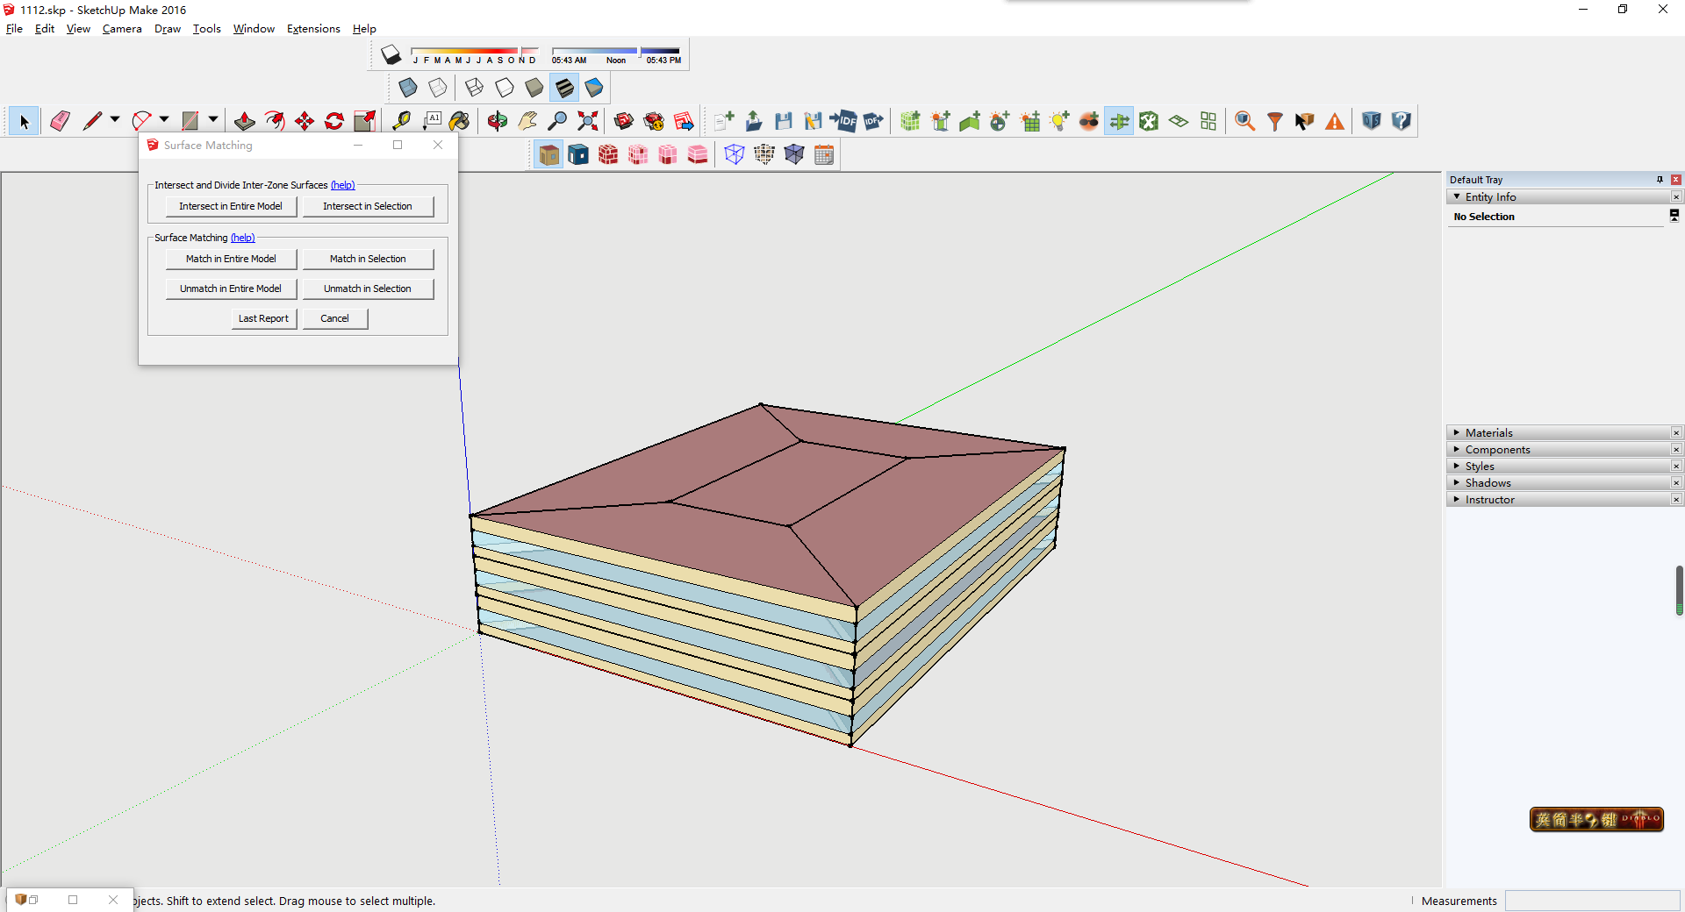
4 press “set windows to wall ratio” to create windows

Slide 5
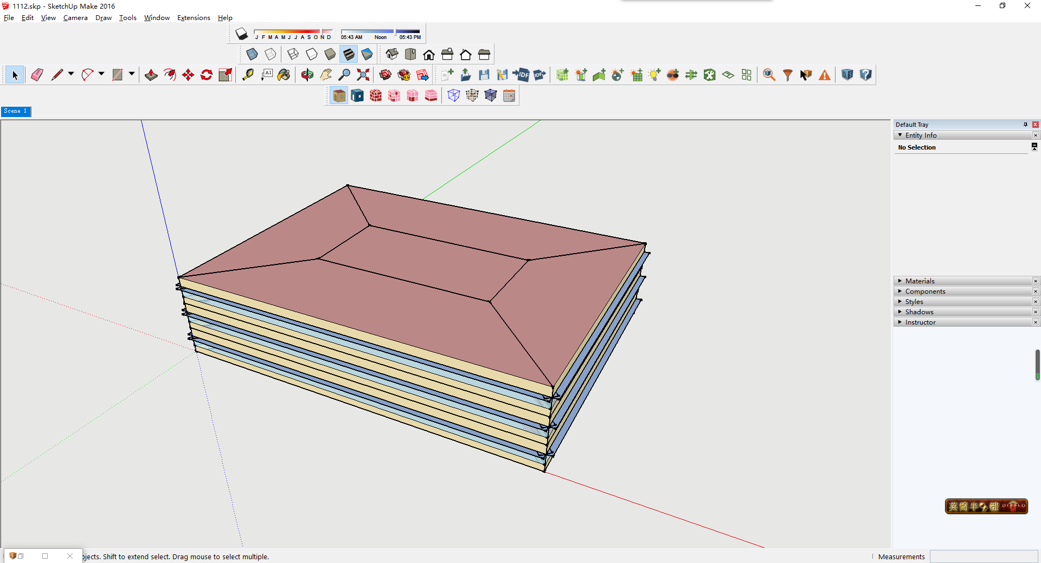
5 select each surfaces except the north side and press “add overhangs by projection factor” to create overhangs

Slide 6
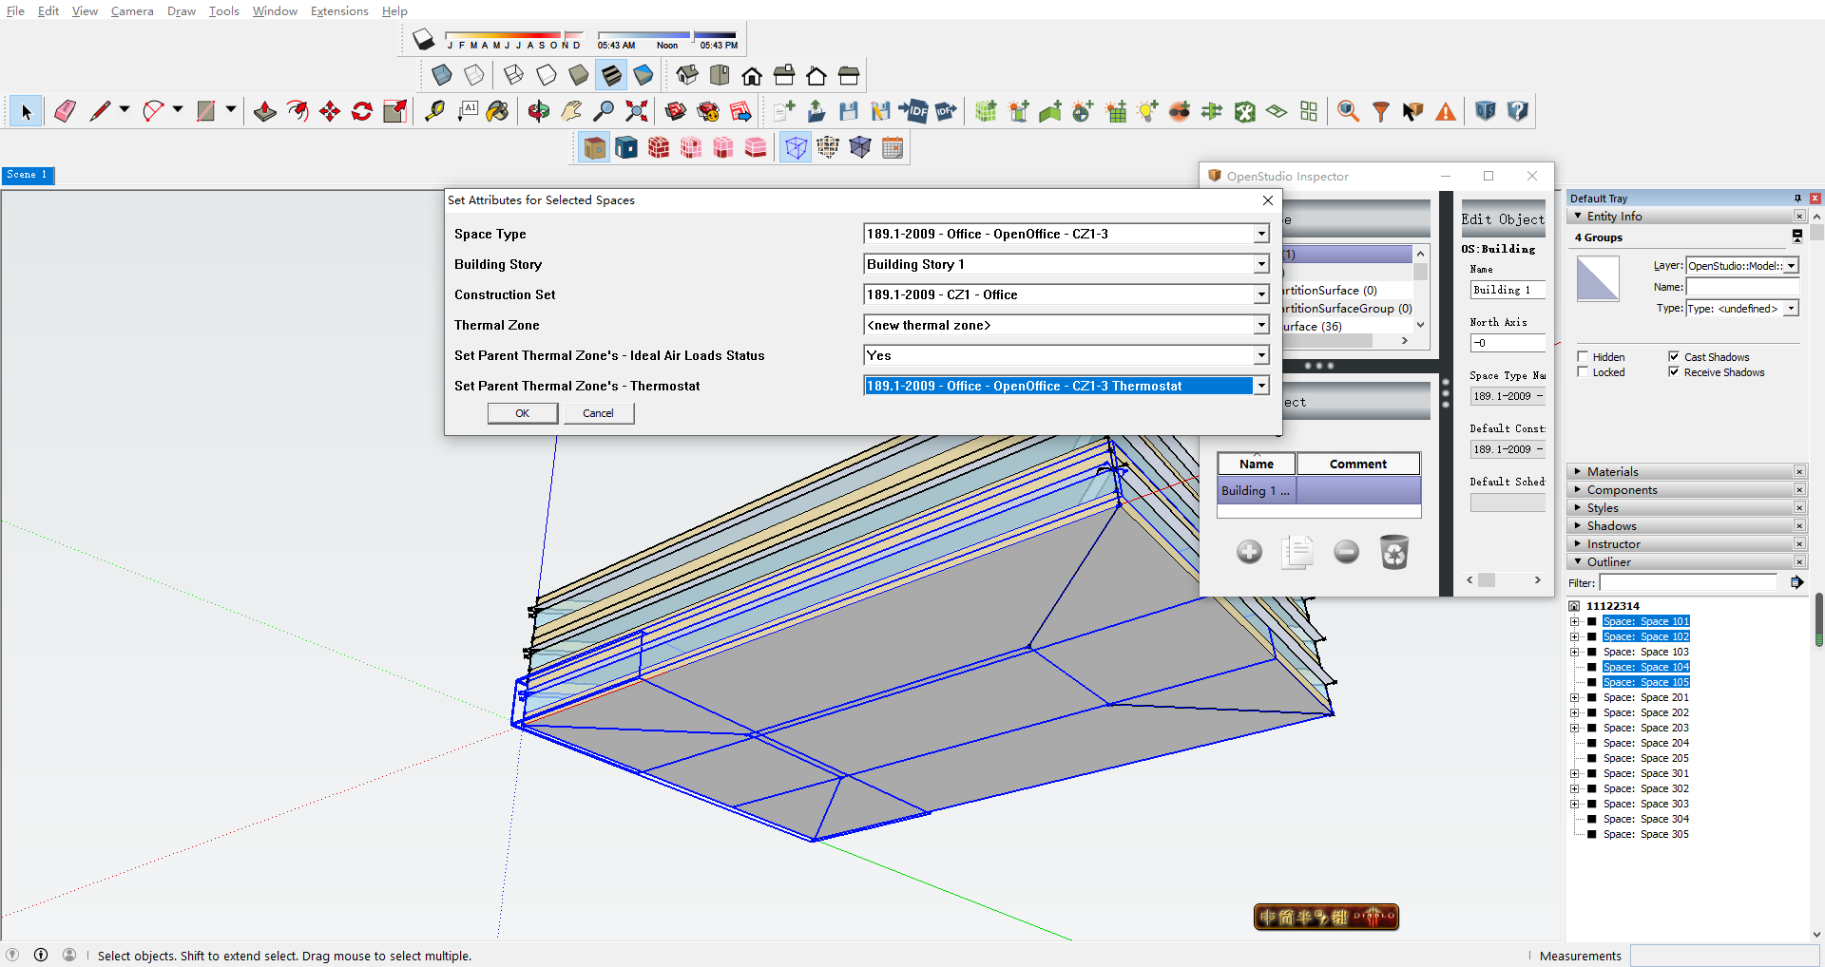
6 create outline and then select space 101 102 103 105
press “set attributes for selected spaces” to build the buttom

Slide 7
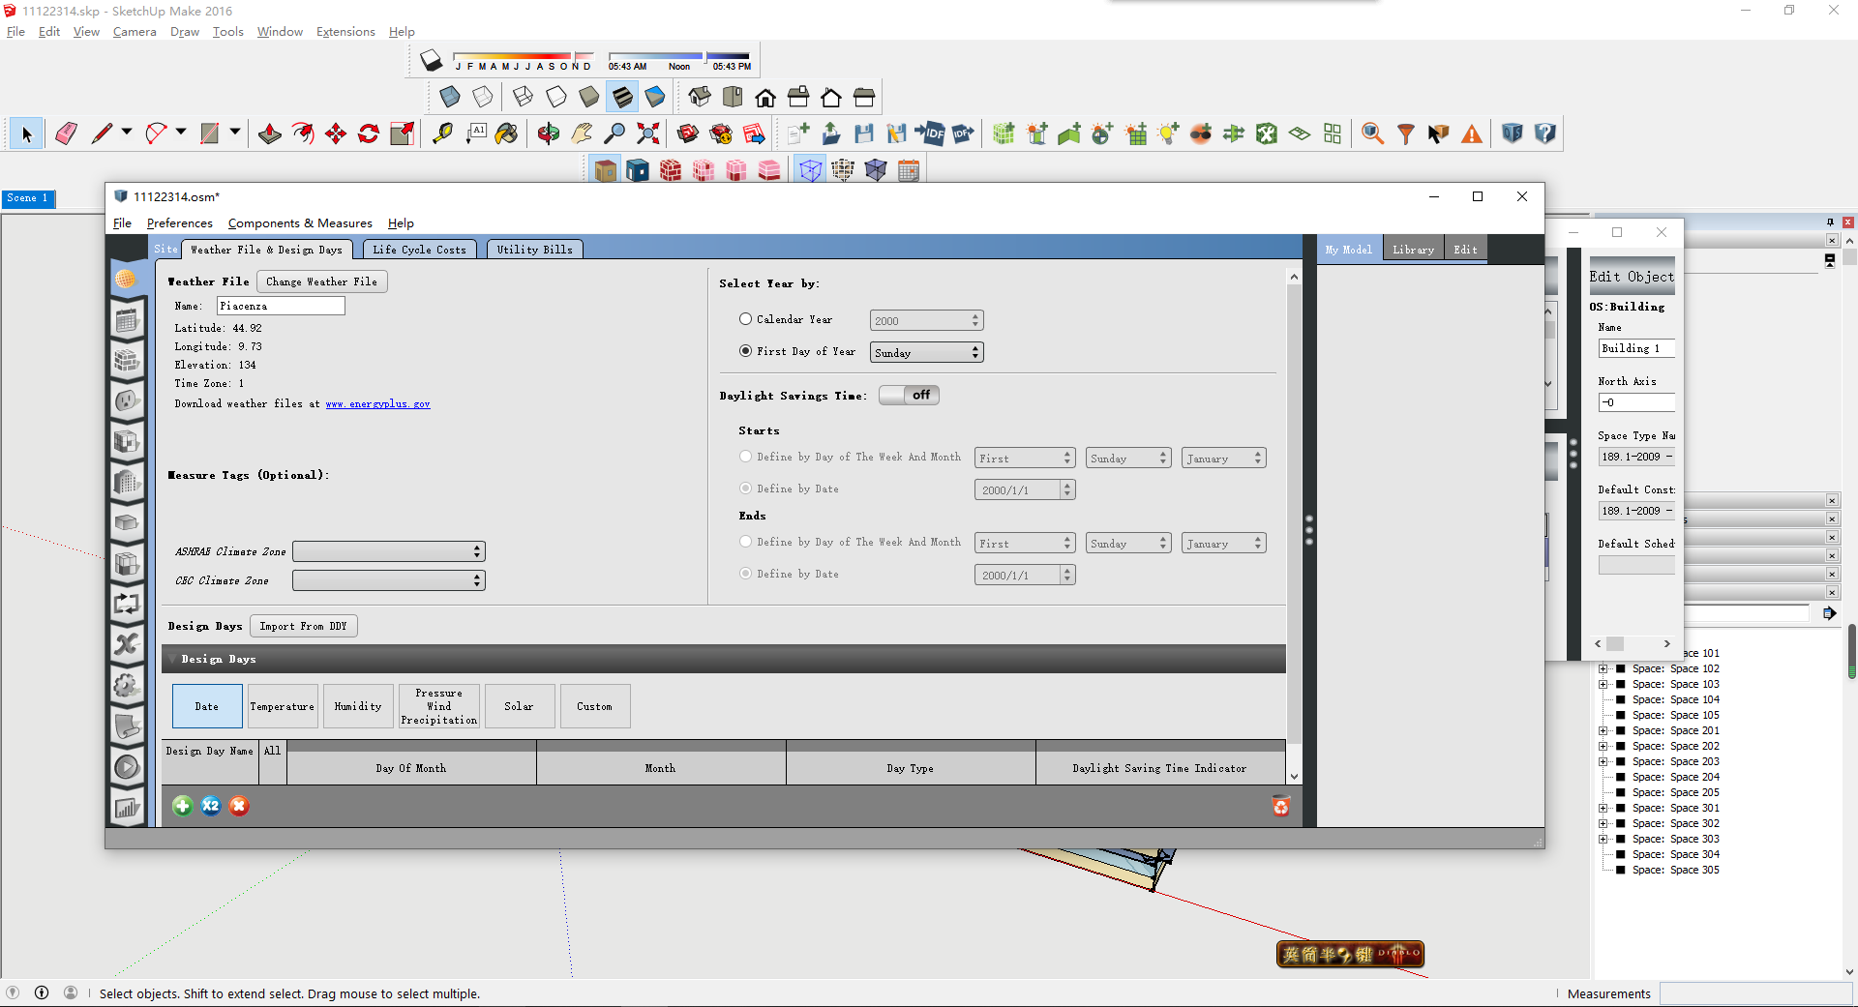
7 launch OSM and then add Piacenza weather data

Slide 8
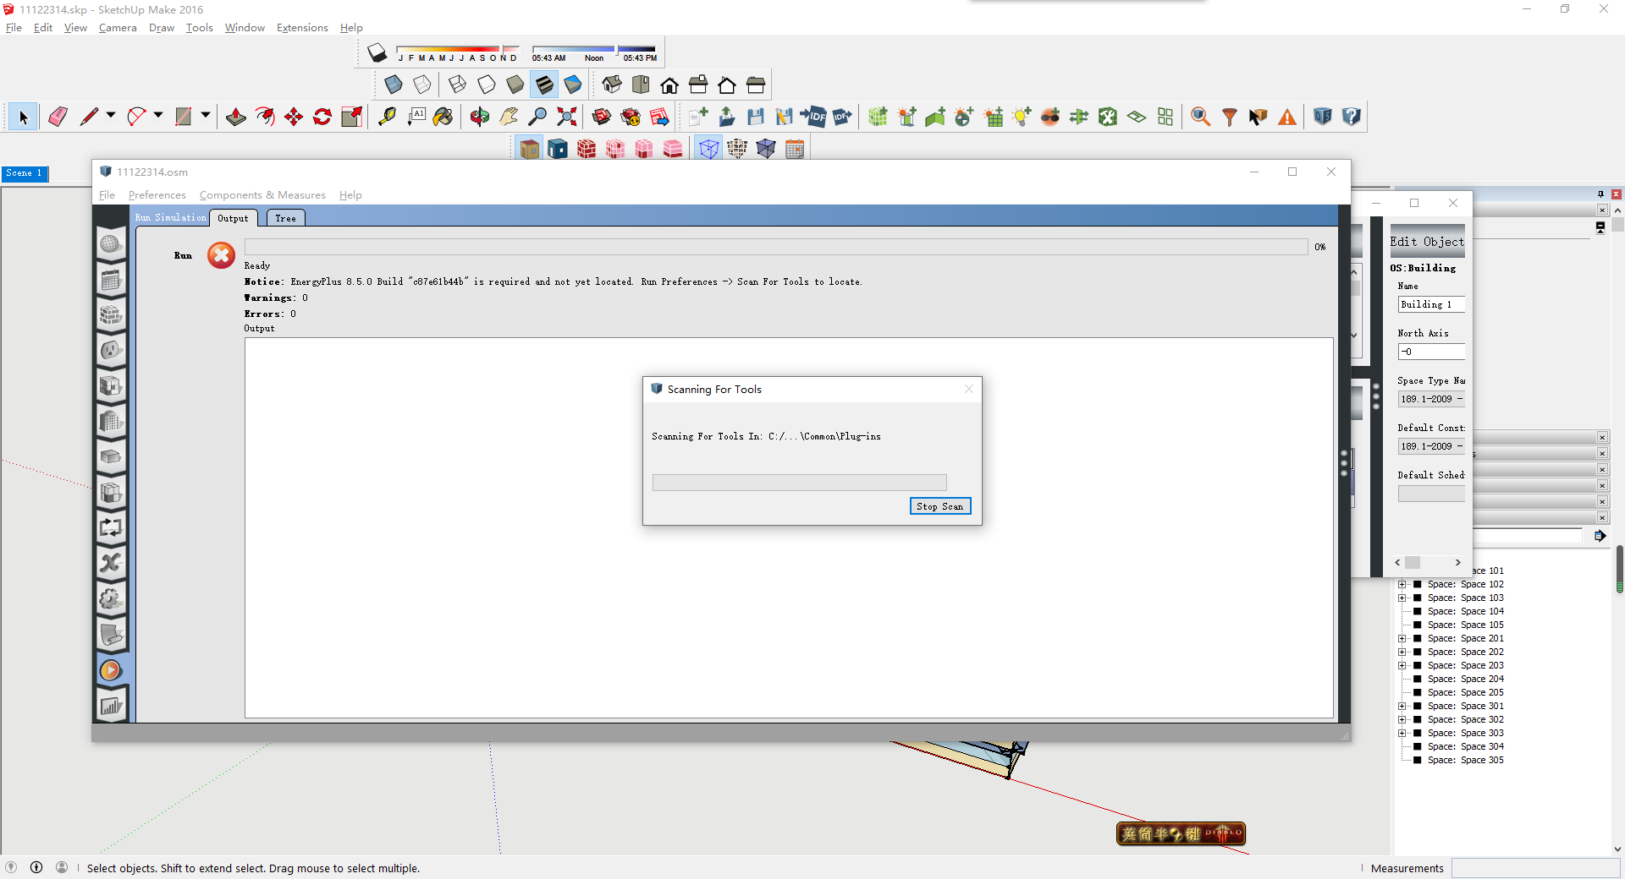
8 Run the model

Slide 9
